Slide 1
DAT Class 13
Cross Validation, Model Prep

Slide 2
Distributional Inference

Slide 3
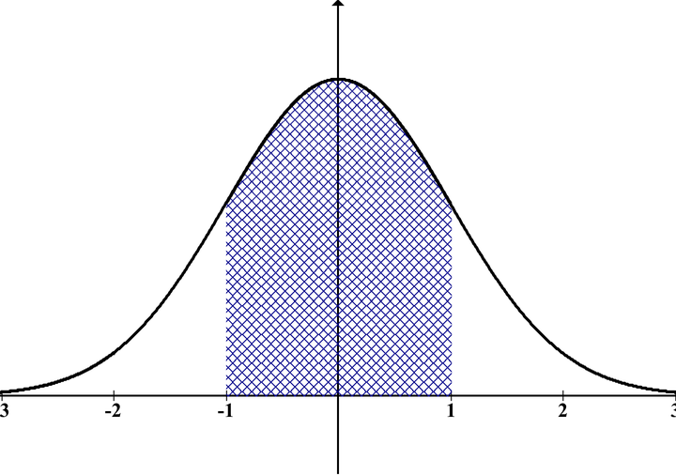
Distributional Inference
One way to classify models is whether or not they’re based on distributional assumptions.
Parametric methods: means model is built on an assumption that data fits a particular statistical distribution
Nonparametric method: no such assumptions
Parametric methods can be more precise in what they’re trying to measure, but are also more prone to failure.
Notes:
This is where you go and introduce the training and test split. Go through the shapes of the returned values, make sure everyone is clear on what’s happening.
For

Slide 4
Distributional Inference
A few examples of parametric models:
Linear regression -- normal distribution
Poisson regression -- linear regression for count data
Gaussian mixture models -- finding sub-distributions within data to make an estimation of a whole
Logistic Regression -- Linear regression for classification
K-Means Clustering -- grouping samples together based on statistical similarity
Notes:
This is where you go and introduce the training and test split. Go through the shapes of the returned values, make sure everyone is clear on what’s happening.
For

Slide 5
Distributional Inference
A few examples of non-parametric models:
Decision Trees -- recursively split data on values that best separate it into separate classes
K Nearest Neighbor -- groups a sample with samples that are closest to it, regardless of
Neural Netowrks (kind of) -- fixed number of weights, but don’t require data to fit a particular pattern
Notes:
This is where you go and introduce the training and test split. Go through the shapes of the returned values, make sure everyone is clear on what’s happening.
For

Slide 6
A Common Question:
How Well Does My Data Fit A Particular
Distribution?
Notes:
This is where you go and introduce the training and test split. Go through the shapes of the returned values, make sure everyone is clear on what’s happening.
For

Slide 7
Distributional Inference
What we’ve done so far: looked at histograms
Problems with this:
Not numerically precise
Subjective: different numbers of bins can give very different impressions
These can generally be used for rough approximations, but fail when you need depth of insight
Notes:
This is where you go and introduce the training and test split. Go through the shapes of the returned values, make sure everyone is clear on what’s happening.
For

Slide 8
Distributional Inference
Other common method: statistical tests
Ie, given the data I have, what are the chances that it is normal?
If the test statistic is < .05, you basically say it doesn’t fit
Common examples:
Mann-whitney
Shapiro-Wilk
Anderson-Darling
Problems:
Way too precise!
Generally not useful w/ N > 2000
Notes:
This is where you go and introduce the training and test split. Go through the shapes of the returned values, make sure everyone is clear on what’s happening.
For

Slide 9
Distributional Inference
A sensible alternative:
The probplot
Does two things:
Generates a hypothetical distribution based on the data that you have
Plots your data vs the hypothetical
Runs a univariate regression against the hypothetical norm and returns an r-squared value
Notes:
This is where you go and introduce the training and test split. Go through the shapes of the returned values, make sure everyone is clear on what’s happening.
For

Slide 10
Distributional Inference
Main benefits:
Combines a nice blend of visual and quantitative insight into distributional fit
Allows you to see where your data does and does not agree with a particular distribution
Can be applied to any distribution that’s supported by scipy: https://docs.scipy.org/doc/scipy/reference/stats.html
Notes:
This is where you go and introduce the training and test split. Go through the shapes of the returned values, make sure everyone is clear on what’s happening.
For

Slide 11
Distributional Inference
Main benefits:
Combines a nice blend of visual and quantitative insight into distributional fit
Allows you to see where your data does and does not agree with a particular distribution
Can be applied to any distribution that’s supported by scipy: https://docs.scipy.org/doc/scipy/reference/stats.html
Notes:
This is where you go and introduce the training and test split. Go through the shapes of the returned values, make sure everyone is clear on what’s happening.
For

Slide 12
Distributional Inference
Main benefits:
Combines a nice blend of visual and quantitative insight into distributional fit
Allows you to see where your data does and does not agree with a particular distribution
Can be applied to any distribution that’s supported by scipy: https://docs.scipy.org/doc/scipy/reference/stats.html
Notes:
This is where you go and introduce the training and test split. Go through the shapes of the returned values, make sure everyone is clear on what’s happening.
For

Slide 13
Target Encoding

Slide 14
Target Encoding
The story so far on categorical encoding:
Ordinal: rank columns in numeric order (1, 2, 3, 4, 5, etc) based on an inherent order (big, medium, small), (good, fair, poor, etc)
Nominal/OneHot: Create a binary representation for variables that don’t have inherent order
Both of these have problems
Notes:
This is where you go and introduce the training and test split. Go through the shapes of the returned values, make sure everyone is clear on what’s happening.
For

Slide 15
Target Encoding
Problems with these methods:
Ordinal: most columns don’t fit this criteria, shoehorning variables into this usually gives bad results
OneHot: can create too many columns.
Example: titanic dataset
Name, ticket, etc
If you one-hot encode these, you have more columns than rows
Notes:
This is where you go and introduce the training and test split. Go through the shapes of the returned values, make sure everyone is clear on what’s happening.
For

Slide 16
Target Encoding
Budgeting your columns:
Hard fail: More columns than rows
Most models won’t converge to an answer
Many models have computation time that scales exponentially with number of columns
Soft fail: values in columns that only appear a dozen or two times, or occur much more frequently in test than train, or vice versa
Helps create flukey, unstable results
Notes:
This is where you go and introduce the training and test split. Go through the shapes of the returned values, make sure everyone is clear on what’s happening.
For

Slide 17
Target Encoding
Common problem:
Lots of important columns have a lot of unique values!
Zip codes
Billing procedures
Names of people, etc
These often put you in a conundrum:
Too important to throw out
But too many unique values to onehot encode
This is called ‘high cardinality’
So what to do?
Notes:
This is where you go and introduce the training and test split. Go through the shapes of the returned values, make sure everyone is clear on what’s happening.
For

Slide 18
Target Encoding
Way of encoding categorical columns numerically but only using one column
Maps results of a groupby() operation from the training set to both the test and training set
Useful way of capturing information about all values in a column
Notes:
This is where you go and introduce the training and test split. Go through the shapes of the returned values, make sure everyone is clear on what’s happening.
For

Slide 19
Regularization
Machine Learning With Python

Slide 20
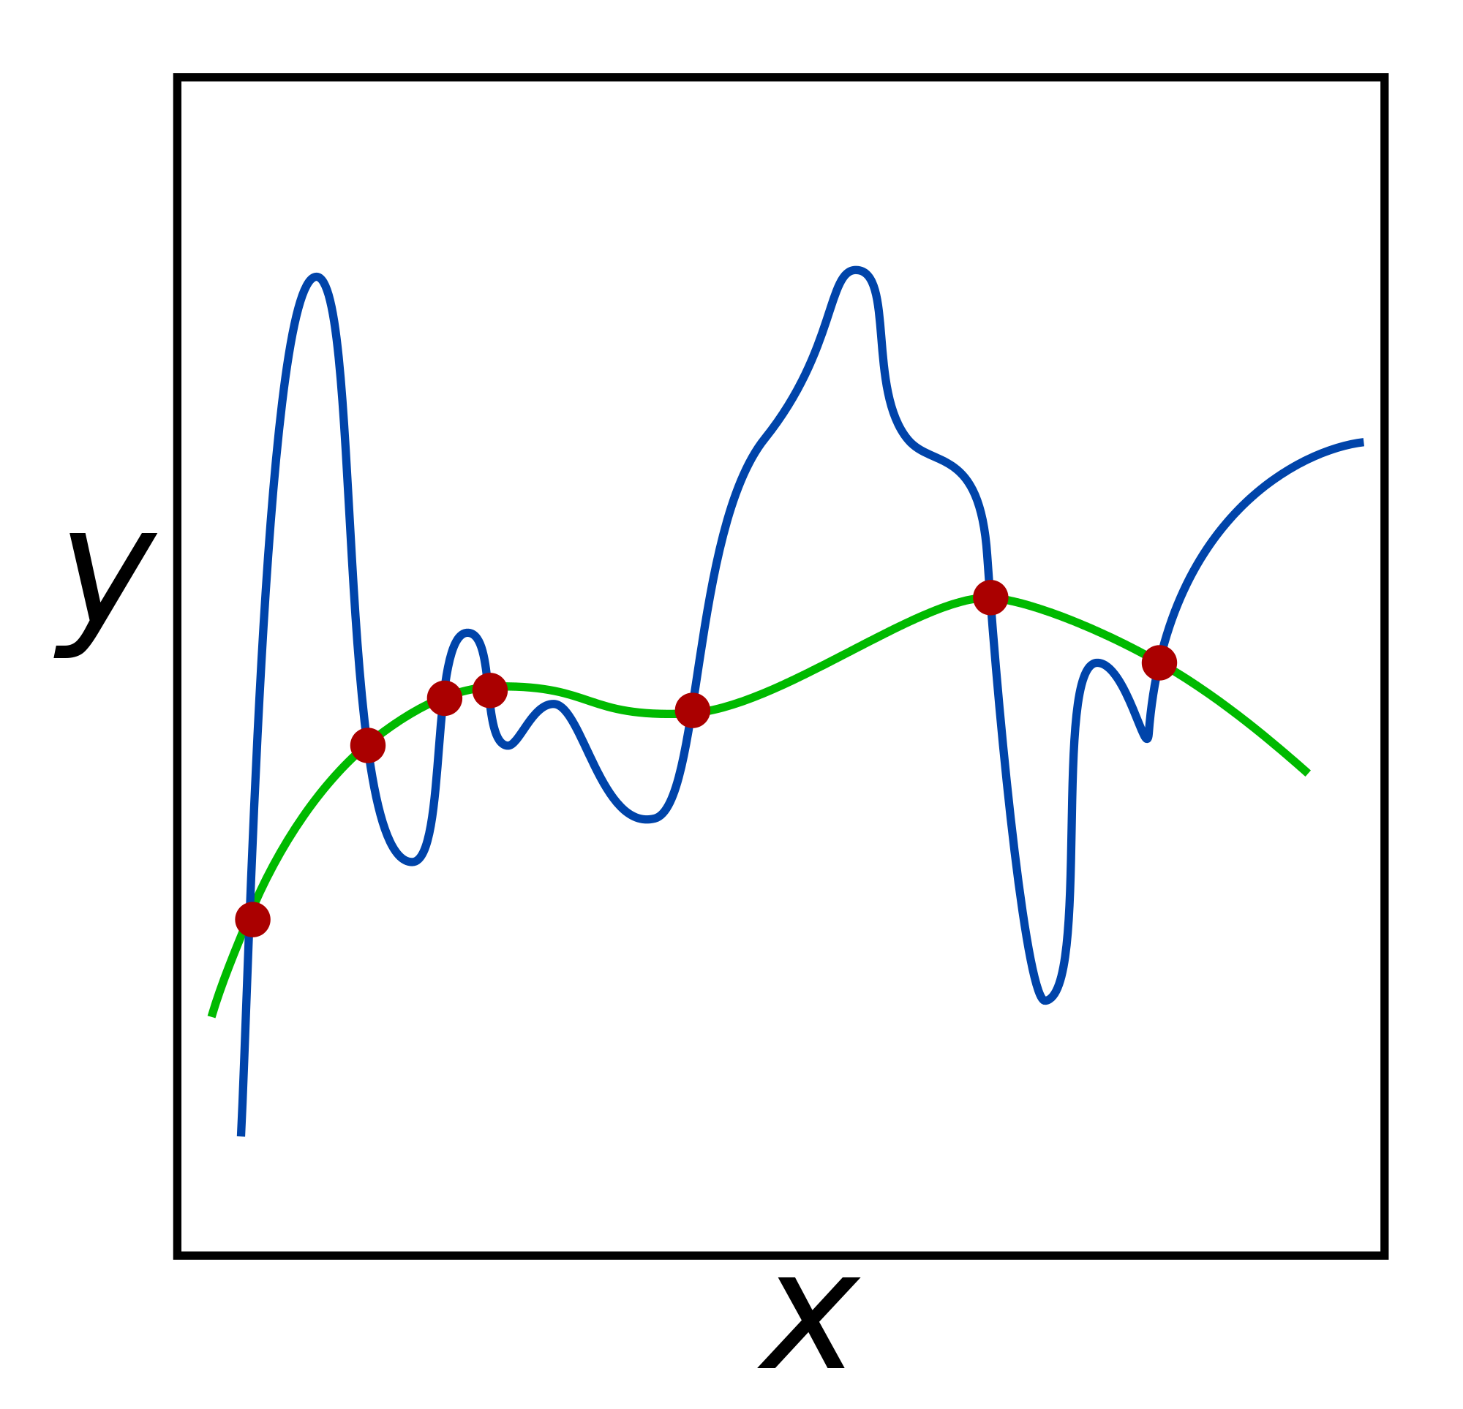
Regularization
Commonly used technique to curb overfitting in your models.
Does so by deliberately injecting a measured amount of bias into your model
You call bias injection a ‘penalty’
Result is that it shrinks your weights
Also known as ‘weight’ decay
Used in most algorithms that use gradient descent for optimization
Notes:
This is where you go and introduce the training and test split. Go through the shapes of the returned values, make sure everyone is clear on what’s happening.
For

Slide 21
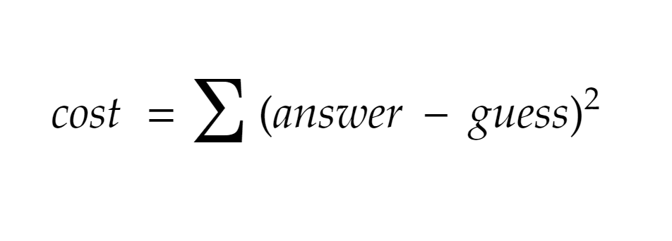

Slide 22
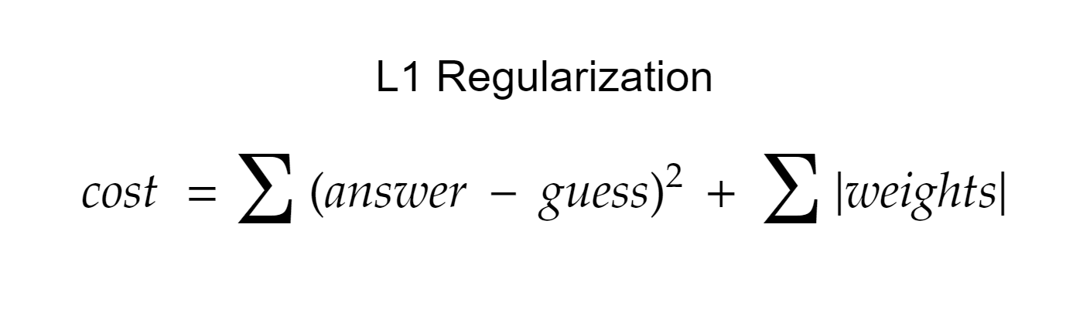

Slide 23
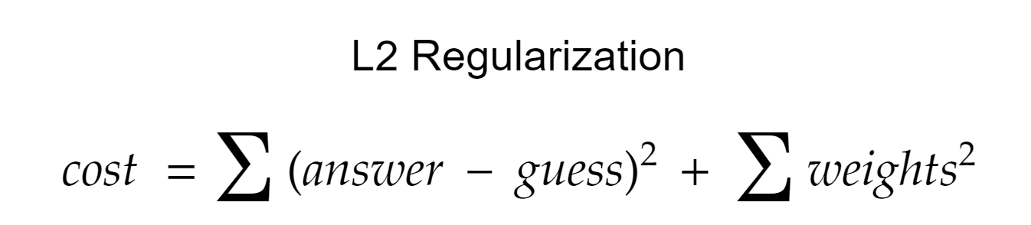

Slide 24
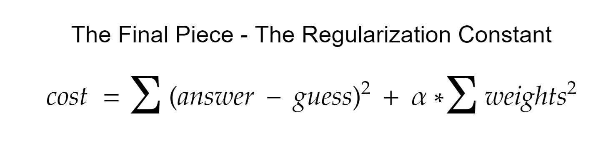
Notes:
Go into your next segment here, and

Slide 25
Regularization
The regularization parameter:
Has different names:
Alpha
Lambda
C
Determines the strength of your regularization
Common parameter to test in cross validation

Slide 26
Regularization
Regression with an L2 penalty is called Ridge Regression
Regression with an L1 penalty is called Lasso Regression
Regularization is used on a lot of ML algorithms - basic concepts are the same throughout
Always a good idea to regularize - to not do it is usually a mistake

Slide 27
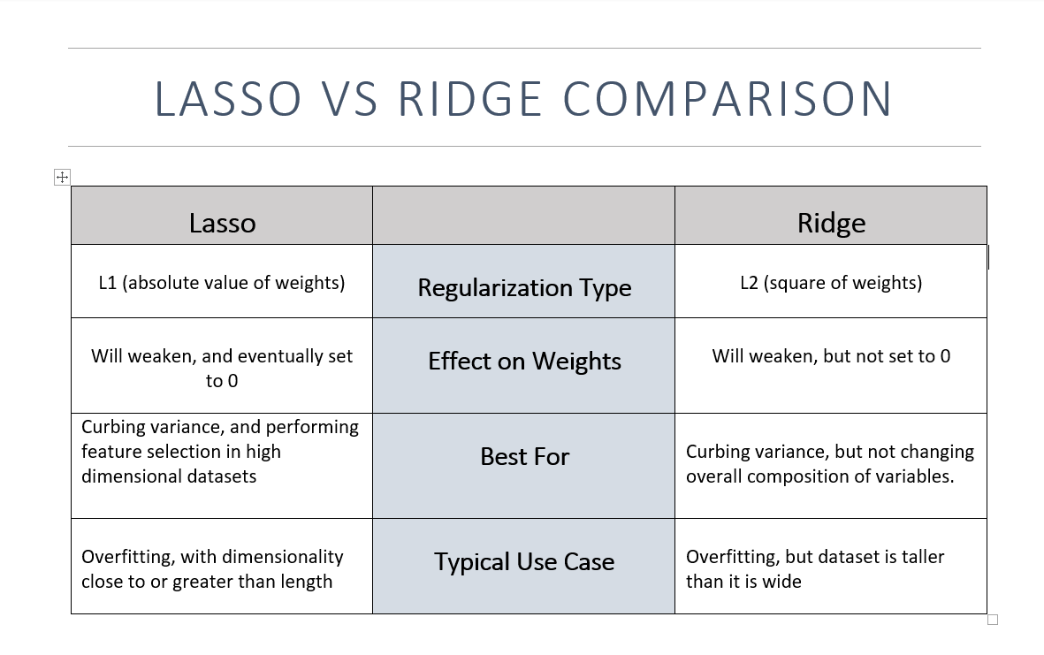
Notes:
After this slide, introduce Ridge Regression, point out alpha as a parameter, and make the chart -- decide for yourself if it’s a good idea to do it by hand or not.

